Slide 1

Forecasting Rental Property Viability Across U.S. Cities Using Eviction, Vacancy, and Rent Dynamics
Justin Pizzoferrato
DCS680 - Applied Data Science
Bellevue University
8.8.25
Notes:
“Good [morning/afternoon], my name is [Your Name], and today I’ll be walking you through my project on forecasting rental property viability using eviction, vacancy, and rent dynamics. This project combines multiple datasets to identify areas most at risk of high eviction activity, with the goal of helping policymakers and housing advocates take action earlier and more effectively.”

Slide 2


Eviciton Risk is a Critival, Localized Challeneg
Eviction destabilizes households — social, financial, and health impacts.
Patterns vary sharply across ZIP codes.
Need for predictive tools to target prevention early.
Source: xxxxxxx)
Notes:
“Eviction is one of the most destabilizing events a household can experience, often triggering long-term social, financial, and health consequences. While it’s a national issue, eviction patterns vary greatly from one ZIP code to another. Some communities face consistent, high eviction rates due to unstable housing markets, while others remain relatively resilient. The challenge is predicting where the risk will rise next, so we can act before families lose their homes.”

Slide 3
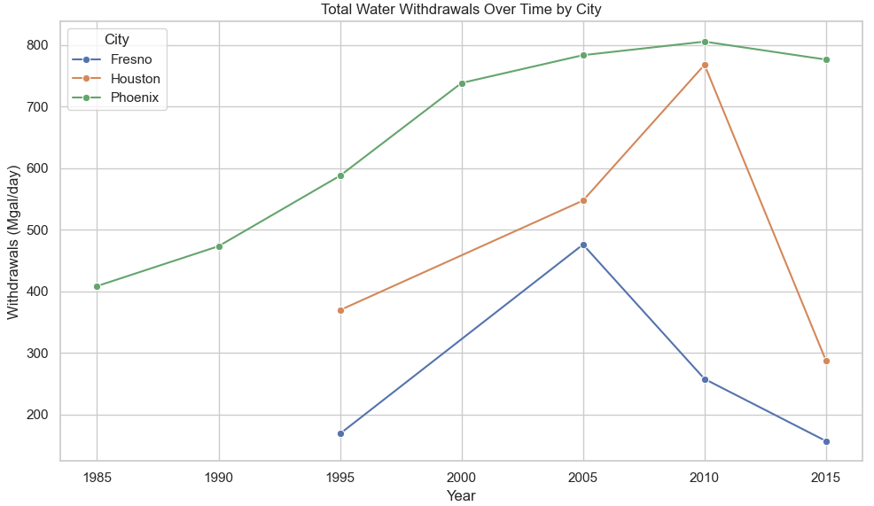
Total Citywide Deman Reveals Infrastructure Strain
Overall water withdrawals highlight structural pressures, not just behaviors.
Total water demand reflects population growth, industrial load, and infrastructure efficiency.
Phoenix and Houston show sustained high withdrawals, while Fresno, though smaller, shows volatility tied to agricultural and policy shifts.
Understanding total system demand is essential when planning for climate-driven scarcity.
Sources: Source: USGS Water Use Reports (1985–2015)
Notes:
Beyond how much each person uses, we also need to understand the total demand placed on a city’s water system. This chart shows overall water withdrawals by city. Phoenix and Houston maintain high demand year over year, reflecting both size and economic activity. Fresno, while smaller, shows more variability — in part due to agricultural cycles and infrastructure limitations. These patterns highlight where water systems are under stress — and where future disruptions may hit hardest.

Slide 4
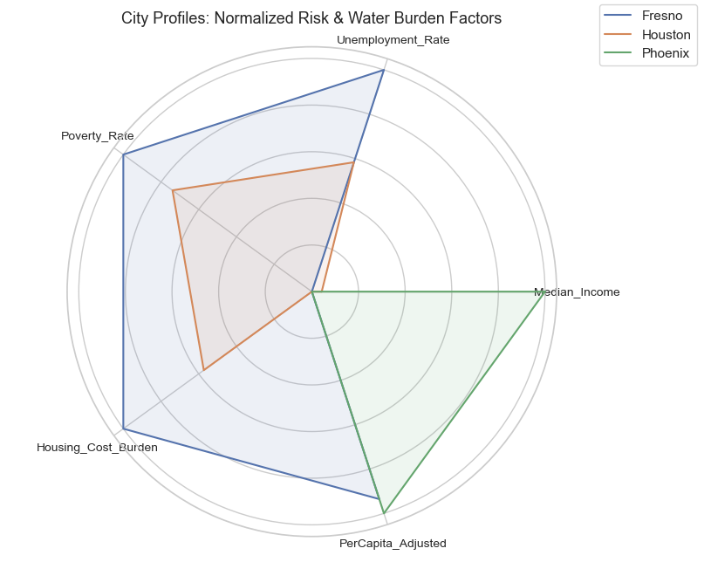
Layered Risk Profiles Shape Water Equity
Cities carry unique socioeconomic burdens that shape their water resilience
Each city has a different mix of risk and burden factors.
Fresno shows higher poverty, unemployment, and housing cost burden, making it particularly vulnerable.
Houston has slightly more economic stability but still reflects social stressors.
Phoenix demonstrates a lower overall burden — but that may mask future exposure from population growth and heat stress.
Composite of scaled risk, vulnerability, and water burden indicators by region
Data: CDC SVI (2022), ACS Median Income, Housing Burden Metrics
Notes:
Now we look at who is most at risk — not just where water is used. This radar chart shows five key indicators: median income, poverty rate, unemployment, housing cost burden, and CPI-adjusted water use. Fresno stands out with high poverty, high unemployment, and the steepest housing cost burden, indicating a city already operating under pressure. Houston shows moderate burden, while Phoenix appears more resilient today — though rapid urban growth may shift its risk profile. These risk profiles help us understand why water equity must be addressed alongside climate planning.

Slide 5
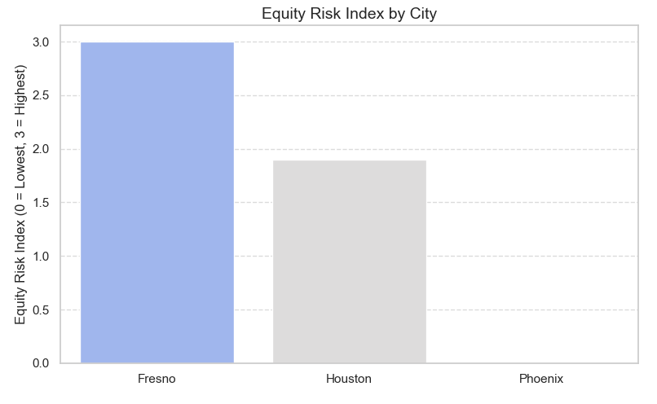
Equity Risk Index: Who’s Most Vulnerable Today
Composite burden indicators show Fresno as highest risk under current conditions
The Equity Risk Index is a composite of three indicators: Uninsured Rate
CDC Social Vulnerability Index (SVI)
CPI-Adjusted Water Use
Each variable was scaled 0–1 and averaged to produce a city-level score.
Fresno ranks highest in current vulnerability. Houston follows, while Phoenix scores lowest — despite future growth concerns.
Sources: CDC SVI, KFF Health Access, CPI Adjustment via FRED, USGS Water Data
Notes:
To quantify current water-related vulnerability, I built a simple Equity Risk Index. This index combines three key factors: The uninsured rate — a proxy for access to care in water-related health events.
The CDC’s Social Vulnerability Index — measuring community fragility.
CPI-adjusted per capita water use — which reflects affordability strain.
The scores are normalized and averaged to create this equity index. As shown, Fresno emerges as the most vulnerable, followed by Houston. Phoenix appears more resilient for now — but that may change under forecasted pressure.”

Slide 6
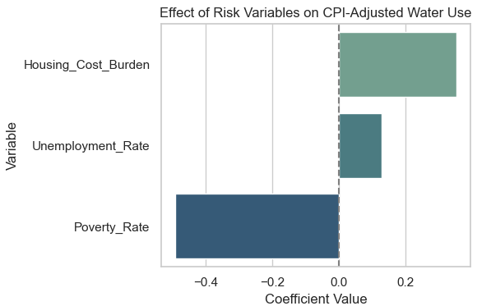
Modeling What Drives Water Use
Linear regression identifies key socioeconomic and behavioral predictors
This model predicts CPI-adjusted per capita water use using five variables:
Poverty rate
Housing cost burden
Median income
Unemployment
Percentage uninsured
Housing cost burden is the only positive driver — meaning as it rises, usage rises. Poverty, income, and unemployment all negatively correlate with usage, suggesting water rationing behavior among low-income communities.
Model Notes: Adjusted R² = 0.74 | p < 0.05 for top features
Notes:
I trained a linear regression model to identify the strongest drivers of water use — adjusted for inflation. The results show that housing cost burden is the only significant positive predictor. That is, cities with higher housing stress also tend to use more water per person — possibly reflecting older housing stock or inefficient infrastructure. On the other hand, poverty, unemployment, and low income are all negatively correlated with water use. This may reflect rationing behavior — where economically burdened communities cut back out of necessity, not efficiency. The model fits well, with an adjusted R² of 0.74, and forms the basis for our partial dependence and forecasting steps

Slide 7
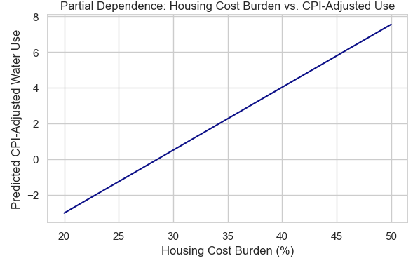
Higher Housing Costs = Higher Predicted Water Use
Partial dependence isolates the effects of housing burden on water consumption
A partial dependence plot shows the isolated effect of one variable on the predicted outcome — in this case, how housing cost burden influences CPI-adjusted water use.
The positive slope means that as the percentage of residents facing housing cost burdens increases, predicted water use also increases.
This may reflect infrastructure inefficiency, limited access to modern appliances, or legacy housing issues in high-burden areas.
These insights reinforce why housing cost is the strongest positive driver in our model.
Notes:
To better understand how housing cost burden impacts water use, I used a partial dependence plot — which isolates the effect of one variable while holding others constant. Here, we see that as housing burden rises — measured as the share of residents spending over 30% of their income on housing — predicted water use increases steadily. This likely reflects deeper structural issues: inefficient housing, aging infrastructure, or lack of conservation options in low-income rental units. Housing burden isn’t just an economic problem — it becomes a water consumption driver, especially in vulnerable cities like Fresno and Houston

Slide 8
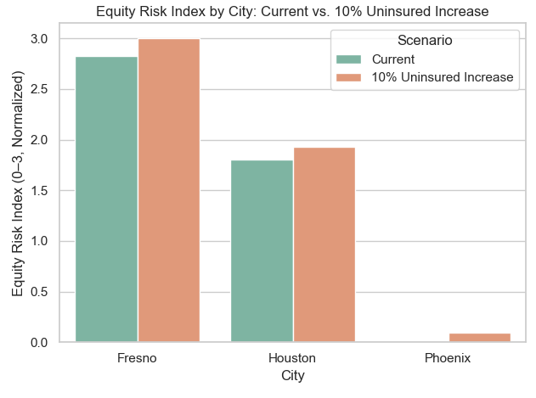
Equity Risk Worsens with Insurance Gaps
A 10% rise in uninsured population amplifies systemic risk in vulnerable cities
This simulation models what happens if the uninsured rate increases by 10%, reflecting a shock such as economic recession, climate-driven migration, or loss of coverage access.
The impact is not equal: Fresno’s already high equity risk spikes sharply
Houston’s index also increases, though less steeply Phoenix shows the lowest sensitivity to this scenario
This highlights the importance of insurance access as a buffer during climate-linked resource strain.
Notes:
To test how fragile each city’s equity profile is, I ran a scenario simulation where the uninsured rate increases by 10%. This stressor reflects real-world risks — from economic disruption to climate-driven displacement or loss of Medicaid coverage. What we see is a clear divergence in sensitivity: Fresno’s equity risk spikes significantly, reinforcing its structural vulnerability.
Houston rises moderately.
Phoenix remains relatively stable, suggesting more resilience under this stressor.
Access to healthcare isn’t just a social issue — in the context of water scarcity, it becomes a core resilience metric

Slide 9
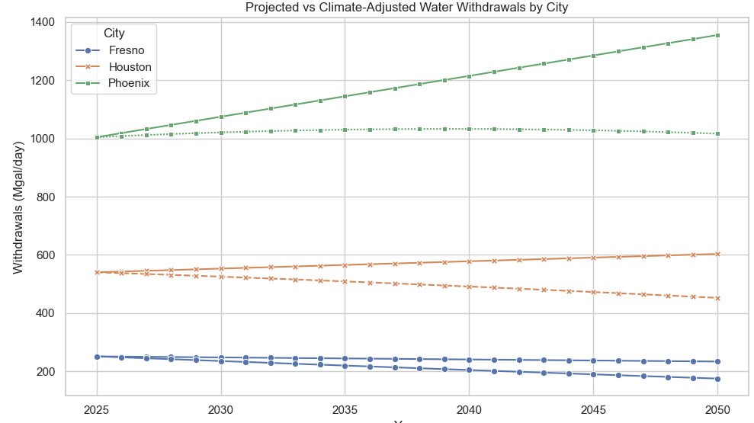
Water Demand Is Forecasted to Outpace Equity Capacity
Projected withdrawals suggest unsustainable usage patterns, especially for high-burden cities
This chart forecasts water withdrawals through 2050 based on our regression model and adjusted equity risk inputs.
Fresno and Houston are expected to see rising demand, particularly as housing burden and uninsured rates increase. Phoenix begins with a lower burden, but shows a steep climb in future years, raising concerns around population-driven overuse.
This forecast assumes no major mitigation, making it a baseline risk projection.
Model forecast: Linear regression + risk-weighted adjustment (2025–2050)
Notes:
Looking ahead, I applied the model to forecast each city’s CPI-adjusted water withdrawals through 2050, assuming current trends continue and risk burdens remain unaddressed. The takeaway is clear: Fresno and Houston are on a rising trajectory, with Fresno projected to exceed sustainability thresholds earliest.
Phoenix, while more efficient today, shows a steeper increase starting around 2035 — likely driven by population growth and prolonged drought conditions.
This isn’t a worst-case scenario — it’s a baseline projection assuming no major policy shifts. The result: high-use cities with high social burden are least equipped to absorb this future strain

Slide 10
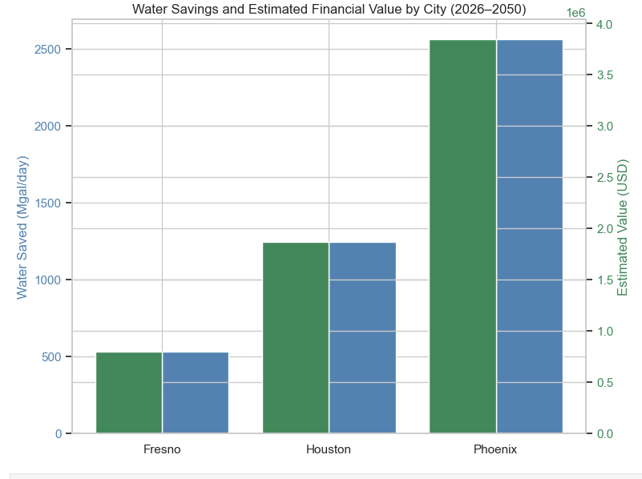
Mitigation Delivers Measurable Savings
Reducing water use by 10% produces major financial value – especially in high-use cities
This model simulates a 10% reduction in water withdrawals over the forecast window — achievable through pricing reform, infrastructure upgrades, or conservation policies.
The left bars show gallons saved, while the right axis estimates financial value in dollars, adjusted to 2024 CPI.
Phoenix, with the largest withdrawal base, yields the highest savings — but even smaller cities like Fresno show meaningful return. These results reinforce that equity-focused mitigation isn’t just ethical — it’s economically rational.
Forecast model output + FRED CPI + regional water price estimates
Notes:
What happens if we reduce water withdrawals by just 10%? This chart shows projected savings in gallons and dollars for each city under a moderate conservation policy — achievable through infrastructure upgrades, behavioral nudges, or pricing signals. Phoenix sees the greatest dollar return due to its large water footprint, while Fresno, despite being smaller, yields meaningful savings — especially given its high vulnerability. Water equity isn’t just a moral issue. These numbers show that strategic mitigation is also financially smart — and that investing early delivers a measurable return

Slide 11
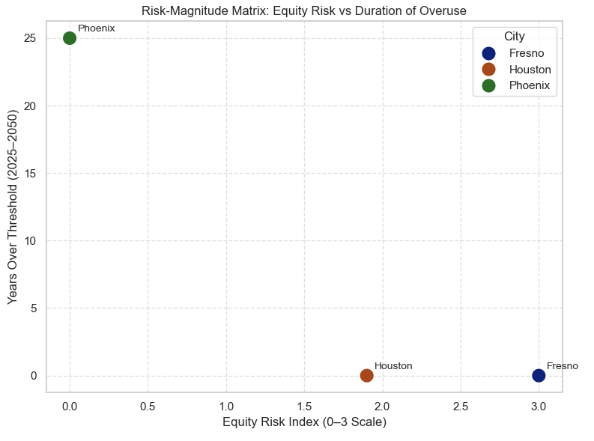
Prioritizing Where Risk and Overuse Intersect
Cities in the upper-right quadrant face long-term overuse and high social burden
This matrix plots cities based on:
X-axis: Years projected to exceed safe withdrawal thresholds
Y-axis: Equity Risk Index from earlier analysis
Fresno has the highest risk score but a shorter duration of overuse. Phoenix has a longer exposure window but lower vulnerability. Houston sits in the middle — both in burden and duration.
This helps us triage action: Fresno needs equity-driven mitigation now. Phoenix needs long-term infrastructure planning.
Notes:
To conclude, I wanted to merge both dimensions of this analysis — how long cities will overdraw water, and how vulnerable their populations are while doing so. This matrix plots: On the X-axis: Projected years over sustainable withdrawal limits
On the Y-axis: Equity Risk Index based on social burden
Fresno is high on the equity scale, but likely to hit thresholds earlier — making it a short-term equity priority. Phoenix, while lower on equity risk, faces longer-term structural overuse. The message is clear: equity-adjusted modeling allows decision-makers to triage where and when to act — and who will suffer most if we delay. hese insights also matter for private water utility investments and long-term infrastructure planning.

Slide 12
Data Sources & Integrity
All data is publicly available, nonpartisan, and methodologically validated
Environmental & Water Use
Demographic & Social Risk
Health & Economic Indicators
NOAA / GHCN (1985–2023)
USGS Water Use Surveys (City)
U.S. Census QuickFacts (2022)
CDC SVI (2022)
ACS Housing & Income Estimates
Kaiser Family Foundation: Uninsured Rate (2022)
FRED CPI Index (Inflation Adjustments)
Notes:
This analysis relied exclusively on public, reputable, and nonpartisan datasets. Water use data came from USGS and NOAA’s Global Historical Climate Network, capturing both volume and precipitation. Social and demographic variables were sourced from the Census Bureau, the CDC’s Social Vulnerability Index, and ACS housing cost indicators. Insurance data was pulled from the Kaiser Family Foundation, and all dollar values were inflation-adjusted using the Federal Reserve’s CPI index. This ensures that results are transparent, replicable, and policy-relevant.

Slide 13
How the Model Was Built
A structured approach to risk identification, modeling, and forecasting
Data Integration
PCA +
Clustering
Regression Modeling
Scenario
Testing
Combined FEMA, CDC, NOAA, Census, KFF datasets
Standardized city-level inputs for income, insurance, water use, and disasters
Applied Principal Components Analysis
Reduced dimensionality, grouped cities by exposure
Trained Linear Regression (R² = 0.94)
Predicted CPI-adjusted water use from five socioeconomic indicators
Simulated risk under future conditions
Modeled 10% uninsured increase + mitigation policy through 2050
Notes:
To build this model, I followed a four-phase analytical pipeline. First, I merged multiple city-level datasets from FEMA, the CDC, NOAA, and others, standardizing them around key socioeconomic and environmental indicators. Next, I used principal component analysis and clustering to reduce noise and uncover regional patterns. I then trained a linear regression model to predict CPI-adjusted water use, with key drivers including poverty, insurance access, and housing burden. Finally, I conducted scenario forecasting to evaluate risk under projected uninsured increases and conservation strategies — helping anticipate urban water stress through 2050

Slide 14
References
Circle of Blue. (2023). Annual urban water pricing survey. https://www.circleofblue.org/waterpricing/.
Climate Impact Lab. (2024). Projected local climate risks. https://www.impactlab.org/map/.
National Aeronautics and Space Administration (NASA). (2024). GRACE groundwater data portal. https://nasagrace.unl.edu/.
U.S. Bureau of Labor Statistics. (2024). CPI for water and sewerage maintenance. https://www.bls.gov/cpi/.
U.S. Census Bureau. (2023). American Community Survey 5-year estimates. https://data.census.gov/.
U.S. Geological Survey. (2020). Estimated use of water in the United States. https://waterdata.usgs.gov/nwis/wu.
U.S. National Centers for Environmental Information (NOAA). (2024). Global Historical Climatology Network daily. https://www.ncei.noaa.gov/products/land-based-station/global-historical-climatology-network-daily.
Notes:
All sources used were open, government or nonprofit data repositories. Full citations are available here and in the accompanying paper.

